Slide 1
Person Detection Using Embarrassingly Parallel Computing
By: Pradyoth Singenahalli Prabhu
Student ID: 02071847

Slide 2
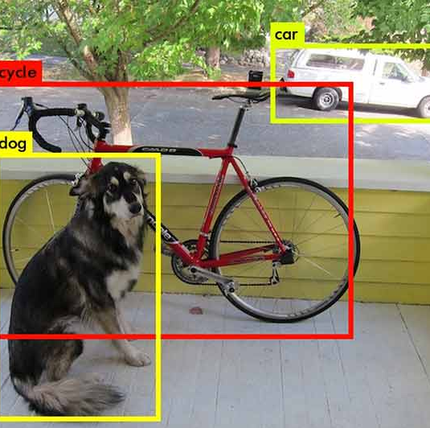
Object Detection
Object detection is a branch of computer vision and image processing. It generally uses Convolution Neural Networks (CNN) for its operations.
It deals with finding instances of semantic items of a specific class (such as individuals, buildings, or cars) in digital photos and videos.

Slide 3
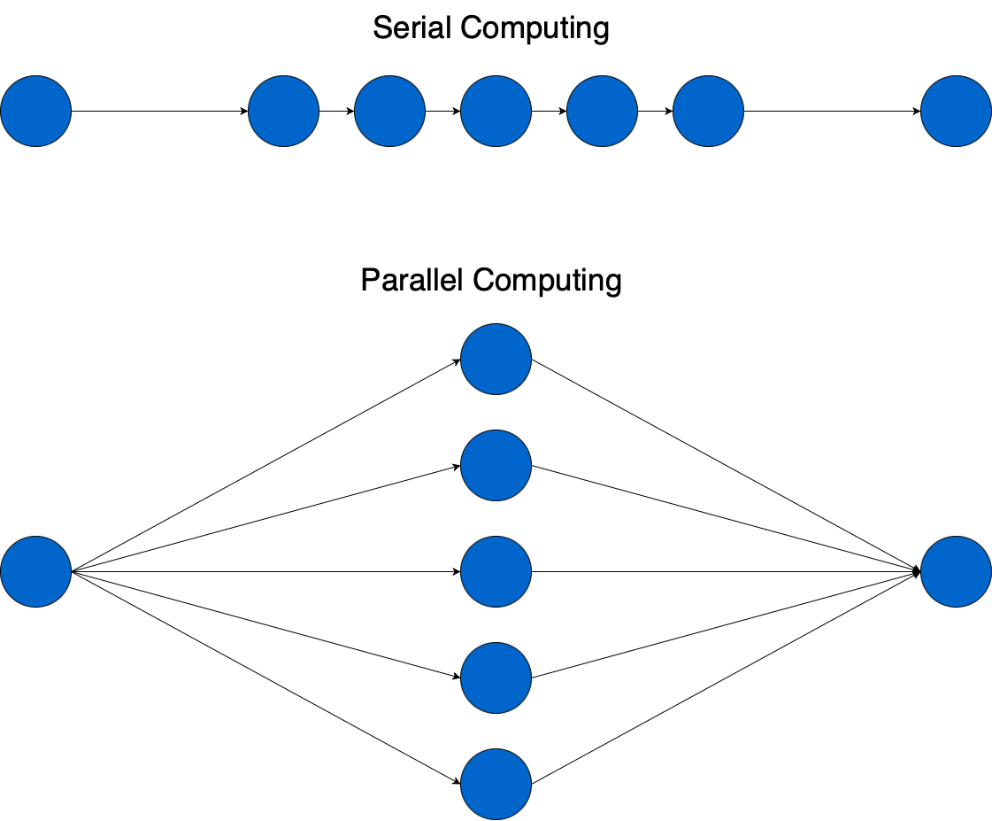
Why Multiprocessing?
Serial: A method of processing where one task is finished at a time and all the tasks are carried out sequentially by the processor. increased processor workload.
Parallel: In this type of processing, multiple tasks are executed at the same time by distinct processors. The task takes less time to perform. Workload per CPU is reduced.

Slide 4
YOLO
Algorithm I am using for detection is YOLOv3 (You Only Look Once, Version 3).
Version 1-3 was created by Joseph Redmon and Ali Farhadi.
Official Versions of YOLO are YOLO v1, YOLOv2, YOLOv3, YOLOv4 and YOLOv7
YOLO is based on framework Darknet-53.
Why YOLOv3?
YOLO has the advantage of being much faster than other networks and still maintains accuracy.

Slide 5
ImageAI
ImageAI is a python library used to build applications and systems with self-contained Deep Learning and Computer Vision capabilities.
ImageAI is a project developed by Moses Olafenwa and John Olafenwa , the DeepQuest AI team.
ImageAI supports object detection, video detection and object tracking using RetinaNet, YOLOv3 and TinyYOLOv3 trained on COCO dataset.
It also allows us to train custom models for performing detection and recognition of new objects.

Slide 6
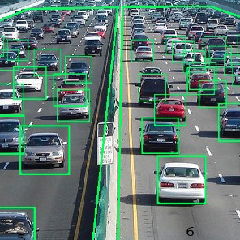
Applications of Person detection
Object detection has been determined the numerous applications in computer vision such as
Object tracking
Data Retrieval
Video surveillance
Image captioning
Image segmentation
Medical Imaging.

Slide 7
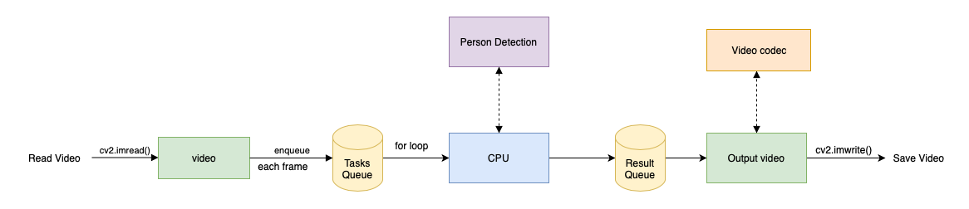
Person Detection - Serial

Slide 8
How can we parallelize person detection?
Version 1:
Parse each frame from a video to get image array.
Pass image array to each core and run person detection function on each core.
Version 2:
Parse each frame from a video and save each frame as an image.
Read each image and pass it to the person detection function on each core.
Save each detected image array as each frame.
Read each frame and stitch all frames to make it a video

Slide 9
Hypothesis
We hypothesize that the person detection will be faster when parallelized.
Allows detection to be performed in parallel.
Overall time taken to communicate with multiprocessors will be faster and more efficient.

Slide 10
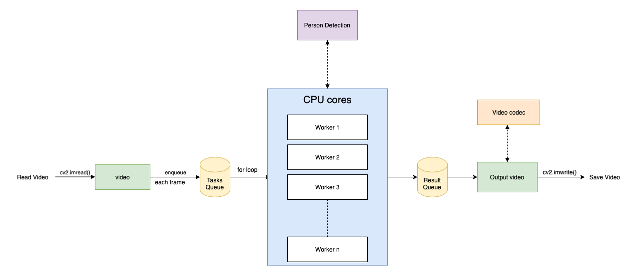
Person Detection – Parallel (version 1)

Slide 11
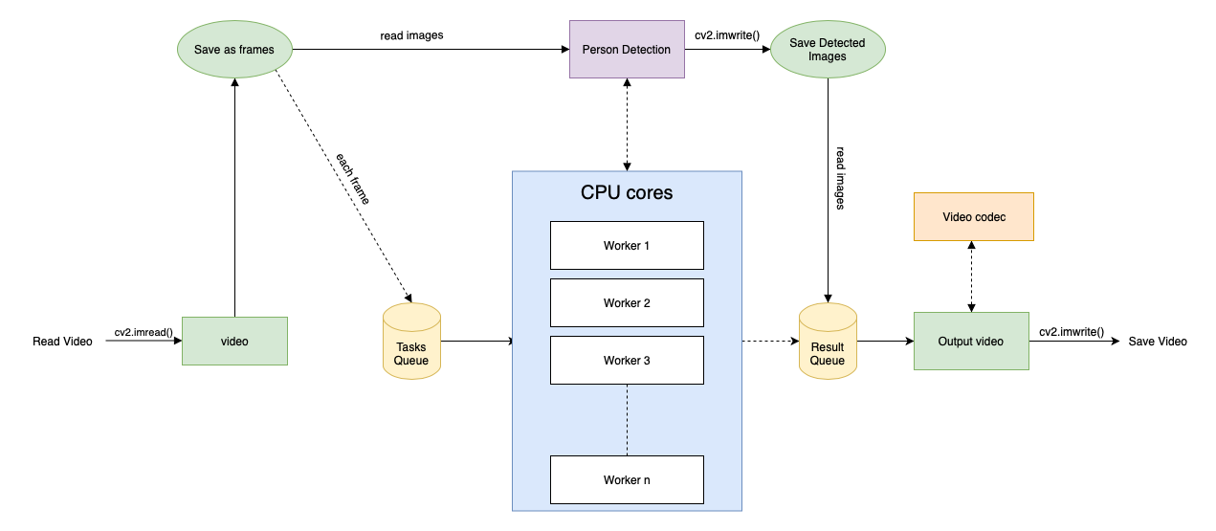
Person Detection – Parallel (version 2)

Slide 12
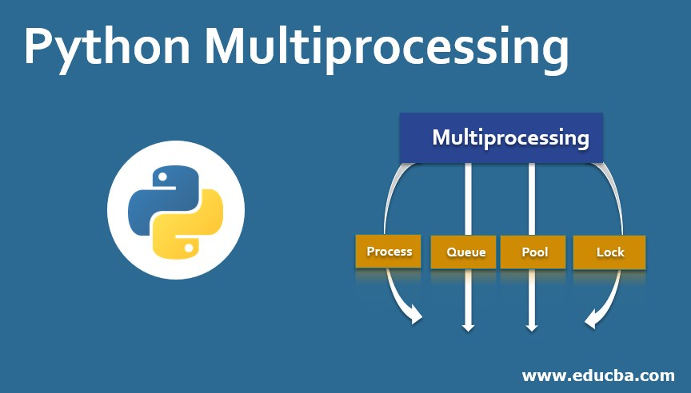

Methods
Serial and parallel are implemented in a Python programming language using library multiprocessing.
For parallelization, using 8 cores in MacBook Pro, whose configuration is Intel i5 (8th generation), and has 8GB RAM.
SSD is being used for video reading and writing.
Resolution of a video I am testing is 3840 × 2160, and the duration is 8 sec.

Slide 13
Results – 8 cores
 | Person Detection
Serial - time taken in sec | 1176.34
Parallel (Version 1) - time taken in sec | 861.45
Parallel (Version 2) - time taken in sec | 485.22
Speedup (Version 1) | 1.365534854
Speedup (Version 2) | 2.424343597
Efficiency (Version 1) | 17.06918568
Efficiency (Version 2) | 30.30429496

Slide 14
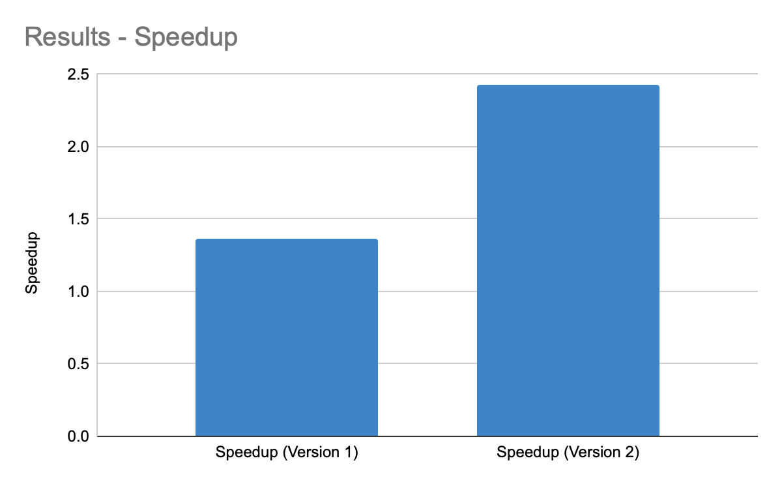
Results – Speedup

Slide 15
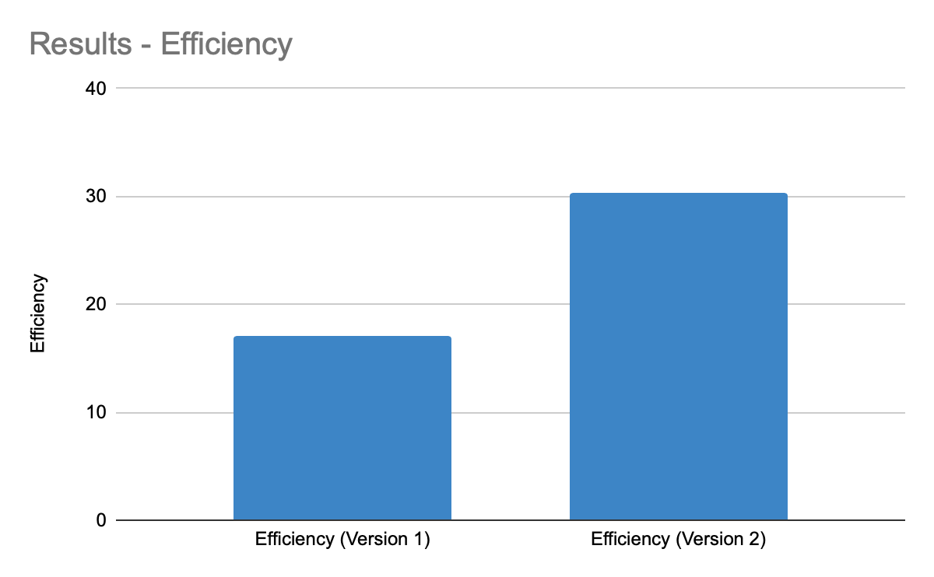
Results – efficiency

Slide 16
Potential improvements
4K video is unnecessary. Could get similar result with lower resolution videos.
Using GPU, much higher speedup could have been achieved.
New version of YOLO (YOLOv7) could be more efficient and more precise.
Python’s multiprocessing has many options for parallelization; can optimize code.

Slide 17
Conclusion
Our hypothesis, using multiprocessing to reduce the time taken is Accepted.
We have also proven that using multiple processes will not decrease the quality of the output.
In parallelization (version 2), time taken to save the frame as images and reading it back reduces a huge time than dealing with image array.

Slide 18
Reference
Python3: https://www.python.org
YOLOv3: https://arxiv.org/abs/1804.02767
ImageAI: https://github.com/OlafenwaMoses/ImageAI/
OpenCV: https://github.com/opencv/opencv-python
Multiprocessing: https://docs.python.org/3/library/multiprocessing.html
Darknet: https://pjreddie.com/darknet/
Testing Video: https://www.pexels.com/search/videos/times%20square/

Slide 19
Thank you

